Slide 1
Unit 1.1: Linear Algebra
IST 718 – Advanced Information Analytics
Adjunct Professor Willard Williamson
linkedin.com/in/ncc-1701-d

Slide 2
Objectives
Review / learn linear algebra basics
Learn how to apply linear algebra to real world problems
Learn how to use python to implement linear algebra operations

Slide 3
Objectives Continued
Will take an “application oriented” approach to linear algebra in this class as opposed to a theoretical approach
Not a comprehensive survey of all linear algebra
Focused on linear algebra subset most relevant to machine learning

Slide 4
Course Text Book
Deep Learning by Ian Goodfellow, Yoshua Bengio & Aaron Couville, MIT Press, 2017:
http://www.deeplearningbook.org/contents/linear_algebra.html
https://www.deeplearningbook.org/slides/02_linear_algebra.pdf

Slide 5
Linear Algebra Deep Dive
Introduction to Linear Algebra, Gilbert Strang:
http://math.mit.edu/~gs/linearalgebra/
Dr. Gilbert Strang is a world famous MIT math professor
Web site above contains links to MIT free linear algebra open courses taught by Dr. Strang.

Slide 6
Introduction
Quote by Gilbert Strang: Linear Algebra has become as basic and applicable as calculas, and fortunately it is easier.
Linear algebra appears in virtually every branch of applied mathematics, physics, mathematical economics, etc.
Linear algebra is very important to
Big data analytics
Machine learning – especially deep learning
Inferential and exploratory statistics
Many other fields in science
Notes:
https://www.ling.upenn.edu/courses/cogs501/LinearAlgebraReview.html
https://math.cornell.edu/life-after-calculus

Slide 7
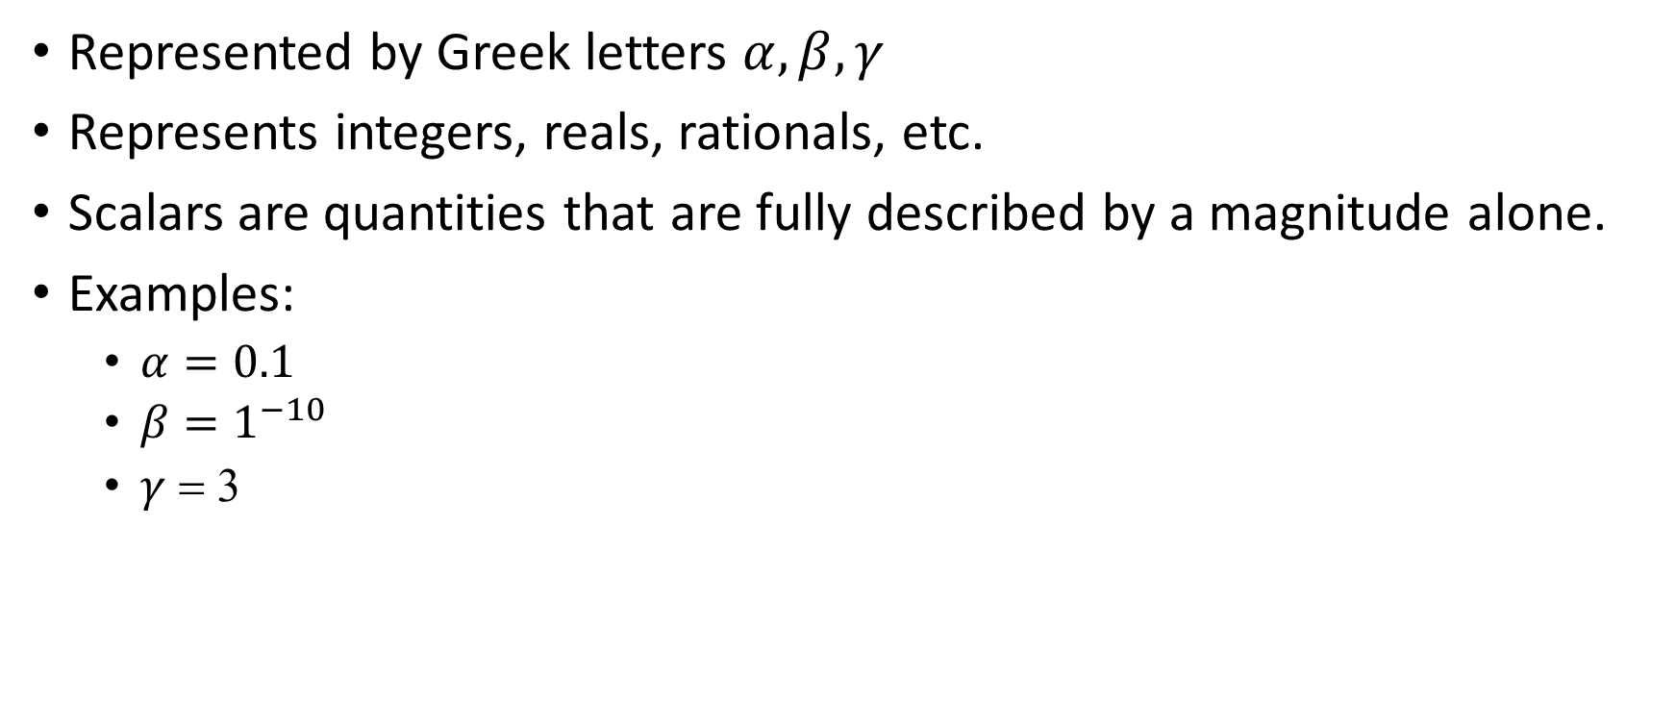
Scalars
Represented by Greek letters $α,β,γ$
Represents integers, reals, rationals, etc.
Scalars are quantities that are fully described by a magnitude alone.
Examples:
$α=0.1$
$β=1^{−10}$
$γ$ = 3
Notes:
https://www.physicsclassroom.com/class/1DKin/Lesson-1/Scalars-and-Vectors

Slide 8

Vectors
Represented by lower case letters
A vector is a 1-D array of scalars:
$a=\left[\begin{aligned}a_{1} \\ a_{2} \\ a_{3} \\ {\begin{aligned}… \\ a\end{aligned}}_{1}\end{aligned}\right]$
A vector is also a single column matrix
Notes:
https://www.physicsclassroom.com/class/1DKin/Lesson-1/Scalars-and-Vectors

Slide 9
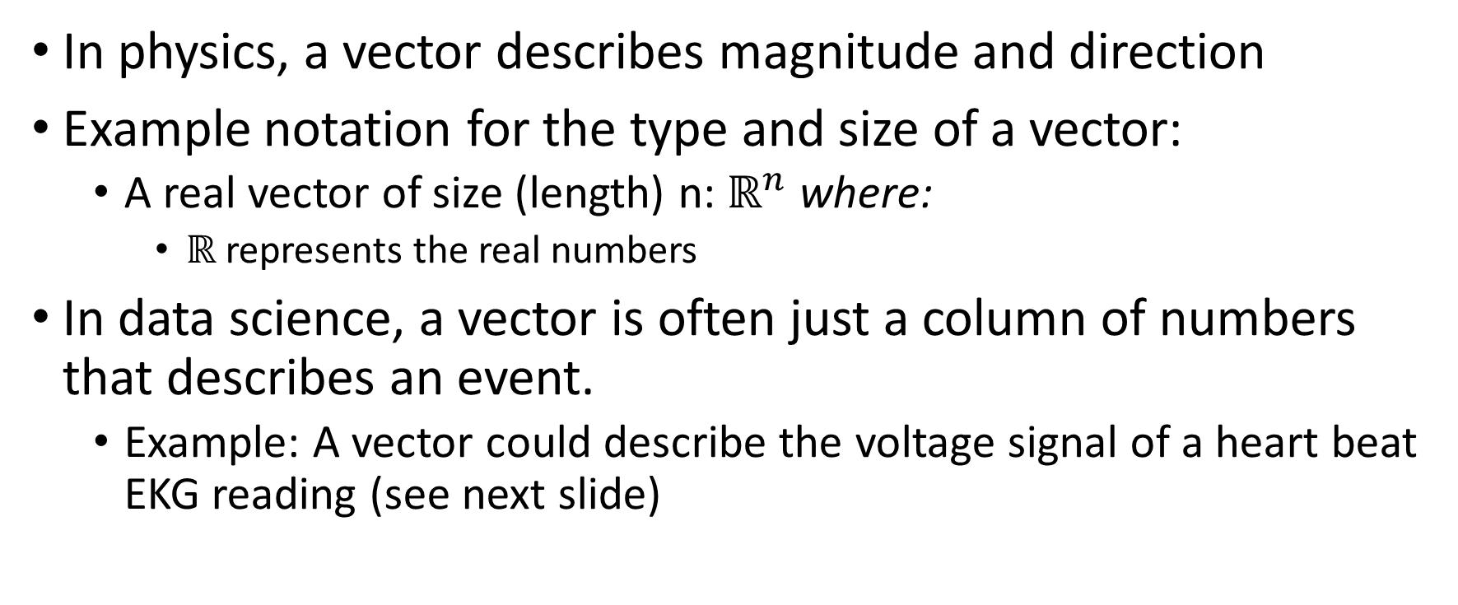
Vectors Continued
In physics, a vector describes magnitude and direction
Example notation for the type and size of a vector:
A real vector of size (length) n: $ℝ^{n}$ where:
$ℝ$ represents the real numbers
In data science, a vector is often just a column of numbers that describes an event.
Example: A vector could describe the voltage signal of a heart beat EKG reading (see next slide)

Slide 10
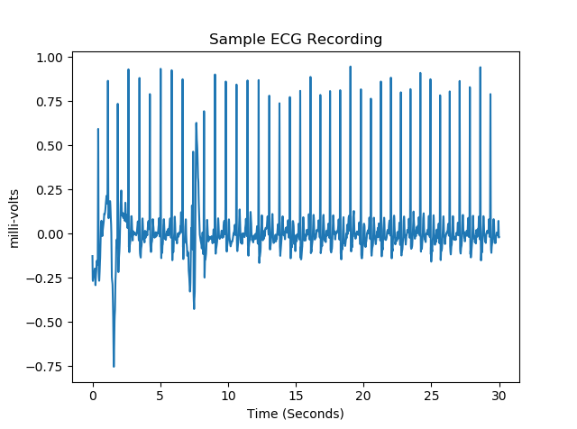
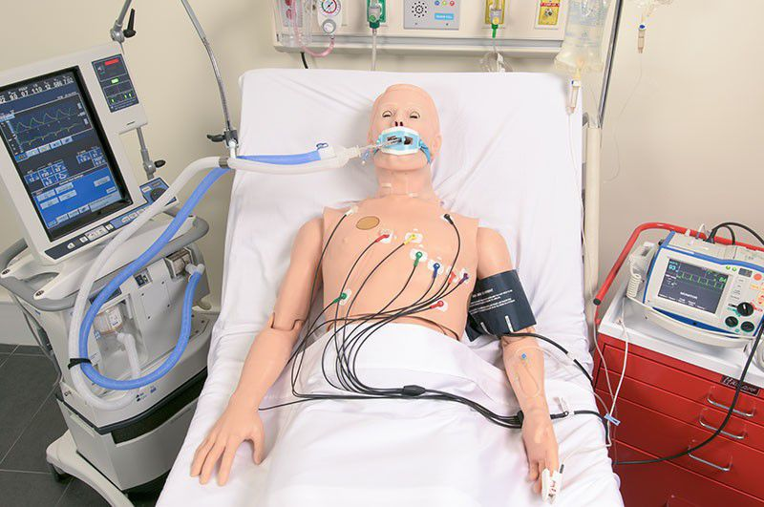
EKG Data Vector

Slide 11
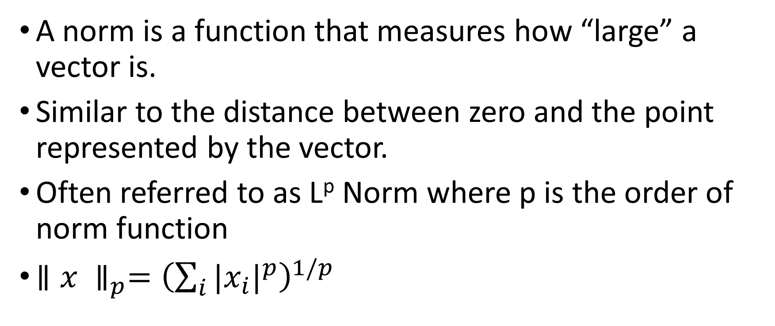
Norms
A norm is a function that measures how “large” a vector is.
Similar to the distance between zero and the point represented by the vector.
Often referred to as L^{p} Norm where p is the order of norm function
${∥x ∥}_{p}={\left(\sum_{i}{{|x_{i}|}^{p}}\right)}^{1/p}$
Notes:
https://machinelearningmastery.com/vector-norms-machine-learning/

Slide 12
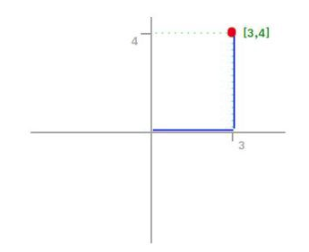
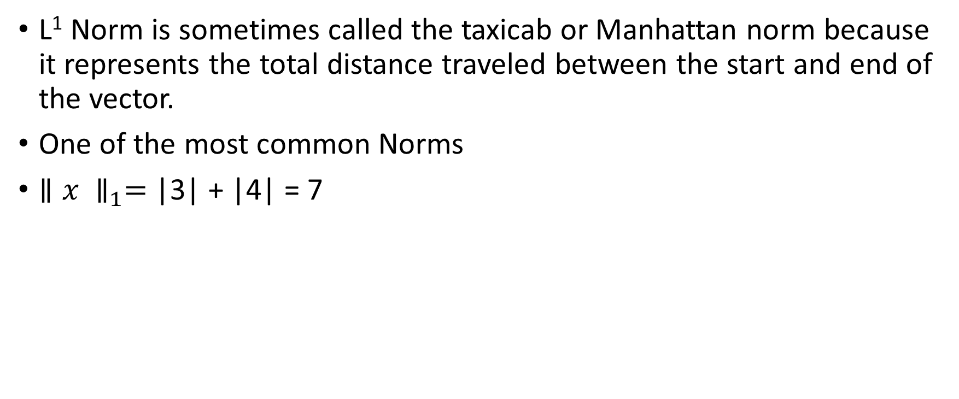
L1 Norm
L¹ Norm is sometimes called the taxicab or Manhattan norm because it represents the total distance traveled between the start and end of the vector.
One of the most common Norms
${∥x ∥}_{1}=$ |3| + |4| = 7

Slide 13
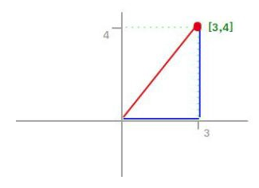

L2 Norm
L² Norm calculates the shortest distance between the start
Also known as the “Euclidian” Norm
${∥x ∥}_{2}=\sqrt{3^{2}+4^{2}}=5$
5

Slide 14

Vector Inner (Dot) Product
The dot product of 2 vectors yields a scalar
Given:
$a=\left[a_{1} a_{2} a_{3}\right]$
$b=\left[b_{1} b_{2} b_{3}\right]$
$a∗b=\sum_{i}{a_{i}b_{i}}$
$\left[a_{1} a_{2} a_{3}\right]∗\left[b_{1} b_{2} b_{3}\right]= \left[a_{1}b_{1}+a_{2}b_{2}+a_{3}b_{3}\right]$

Slide 15
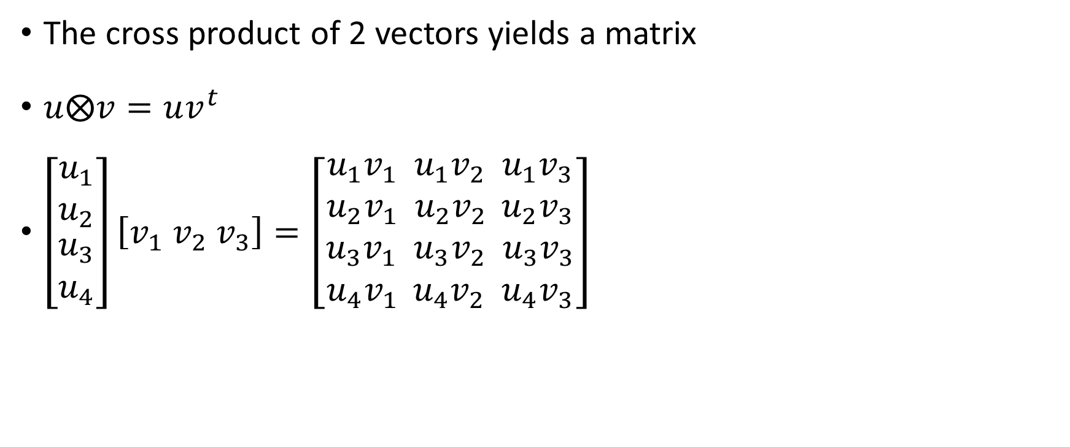
Vector Outer (Cross) Product
The cross product of 2 vectors yields a matrix
$u⨂v=uv^{t}$
$\left[\begin{matrix}u_{1} \\ u_{2} \\ \begin{aligned}u_{3} \\ u_{4}\end{aligned}\end{matrix}\right]\left[v_{1}{ v}_{2}{ v}_{3}\right]=\left[\begin{aligned}u_{1}v_{1} u_{1}v_{2} u_{1}v_{3} \\ u_{2}v_{1} u_{2}v_{2 } u_{2}v_{3} \\ u_{3}v_{1} u_{3}v_{2} u_{3}v_{3} \\ u_{4}v_{1 } u_{4}v_{2} u_{4}v_{3}\end{aligned}\right]$

Slide 16
Vector Outer (Cross) Product Properties
Given 2 linearly independent vectors, a cross b yields a vector that is perpendicular to both a and b and is thus normal to the plane containing them.
If 2 vectors have the same direction, opposite directions, or 0 length then the vectors are not linearly independent and the cross product is zero.
Cross product is also called “Vector Product”
See https://en.wikipedia.org/wiki/Cross_product
See https://www.mathsisfun.com/algebra/vectors-cross-product.html

Slide 17
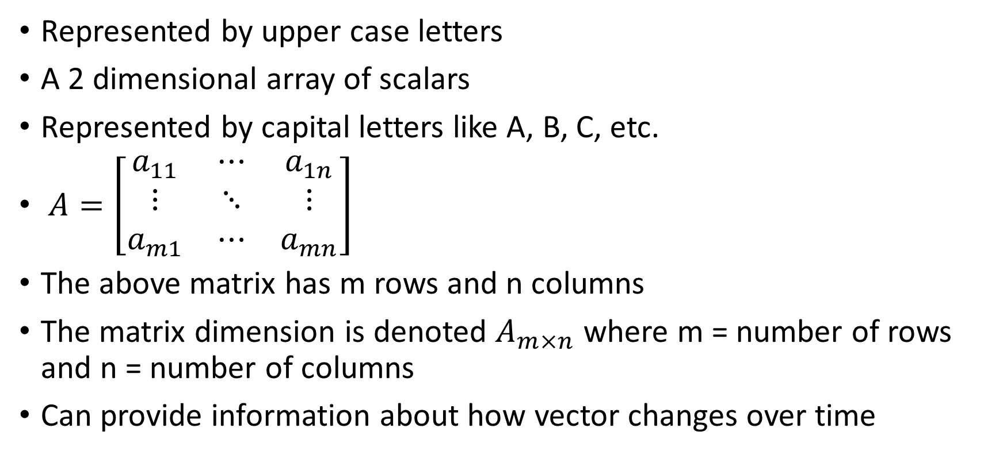
Matrices
Represented by upper case letters
A 2 dimensional array of scalars
Represented by capital letters like A, B, C, etc.
$A=\left[\begin{matrix}a_{11} & ⋯ & a_{1n} \\ ⋮ & ⋱ & ⋮ \\ a_{m1} & ⋯ & a_{mn}\end{matrix}\right]$
The above matrix has m rows and n columns
The matrix dimension is denoted $A_{m×n}$ where m = number of rows and n = number of columns
Can provide information about how vector changes over time

Slide 18
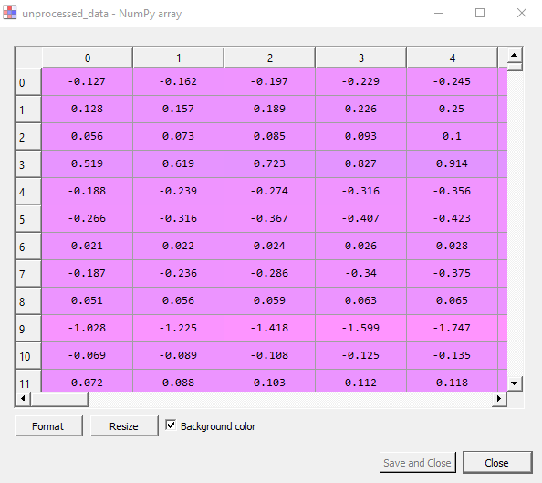

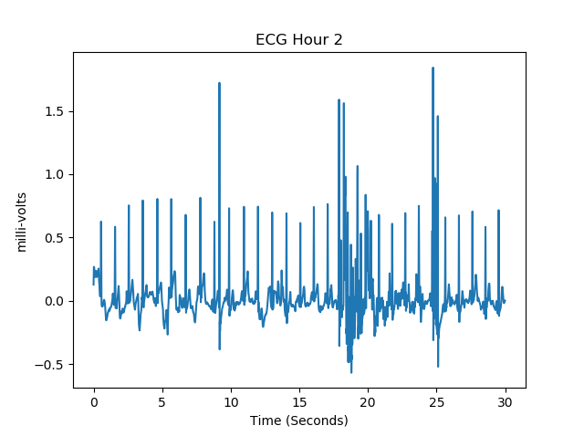
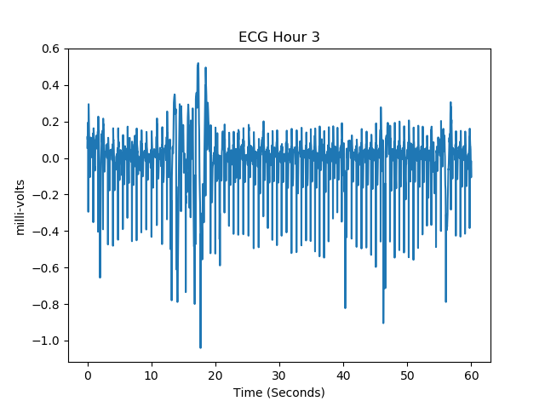
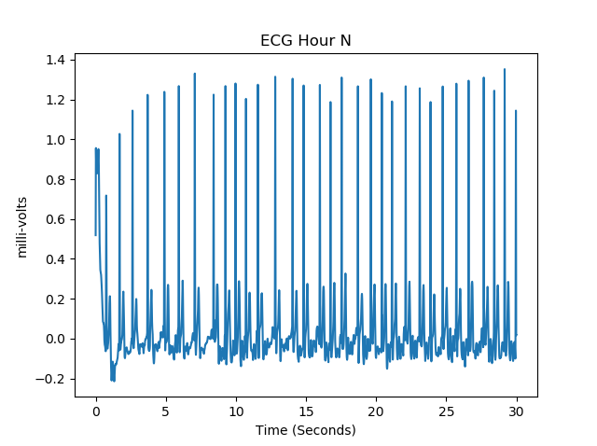
EKG Matrix: Each Col Is A Recording

Slide 19
Matrix Operations
Addition / subtraction
Scalar multiplication
Inner product (dot product)
Transpose

Slide 20
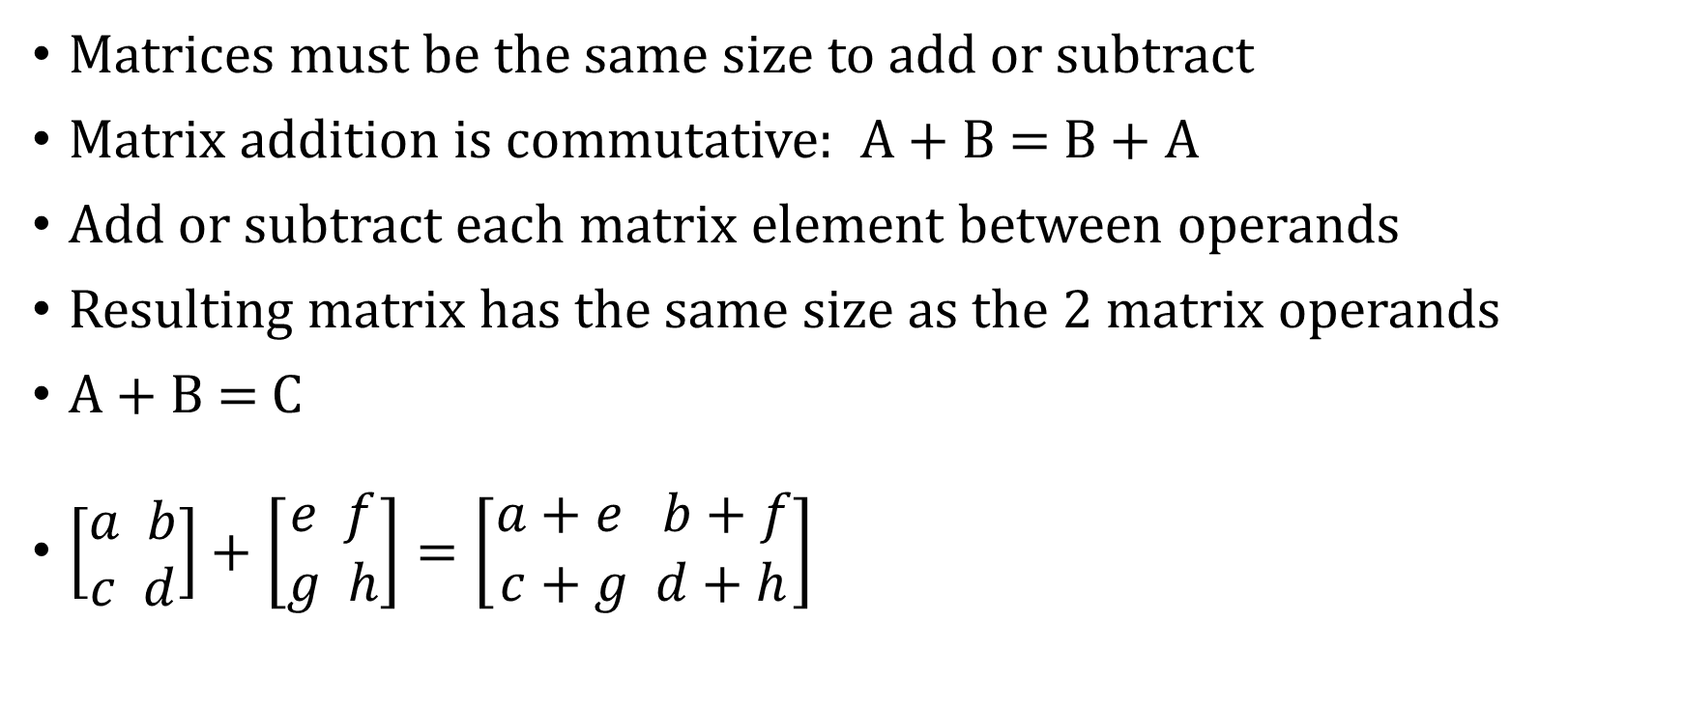
Matrix Addition / Subtraction
Matrices must be the same size to add or subtract
Matrix addition is commutative: A + B = B + A
Add or subtract each matrix element between operands
Resulting matrix has the same size as the 2 matrix operands
A + B = C
$\left[\begin{aligned}a b \\ c d\end{aligned}\right]+\left[\begin{aligned}e f \\ g h\end{aligned}\right]=\left[\begin{aligned}a+e b+f \\ c+g d+h\end{aligned}\right]$

Slide 21
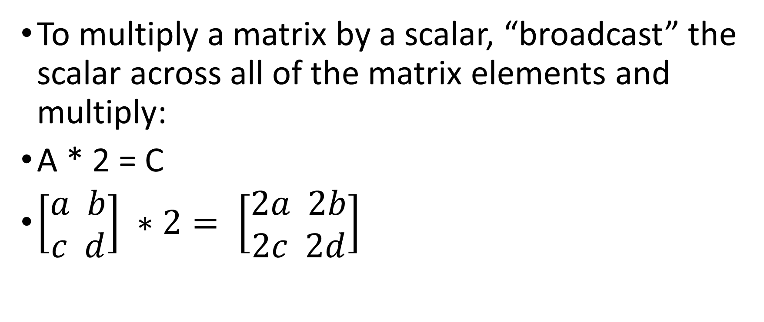
Matrix Multiplication by Scalar
To multiply a matrix by a scalar, “broadcast” the scalar across all of the matrix elements and multiply:
A * 2 = C
$\left[\begin{aligned}a b \\ c d\end{aligned}\right] ∗2= \left[\begin{aligned}2a 2b \\ 2c 2d\end{aligned}\right]$

Slide 22
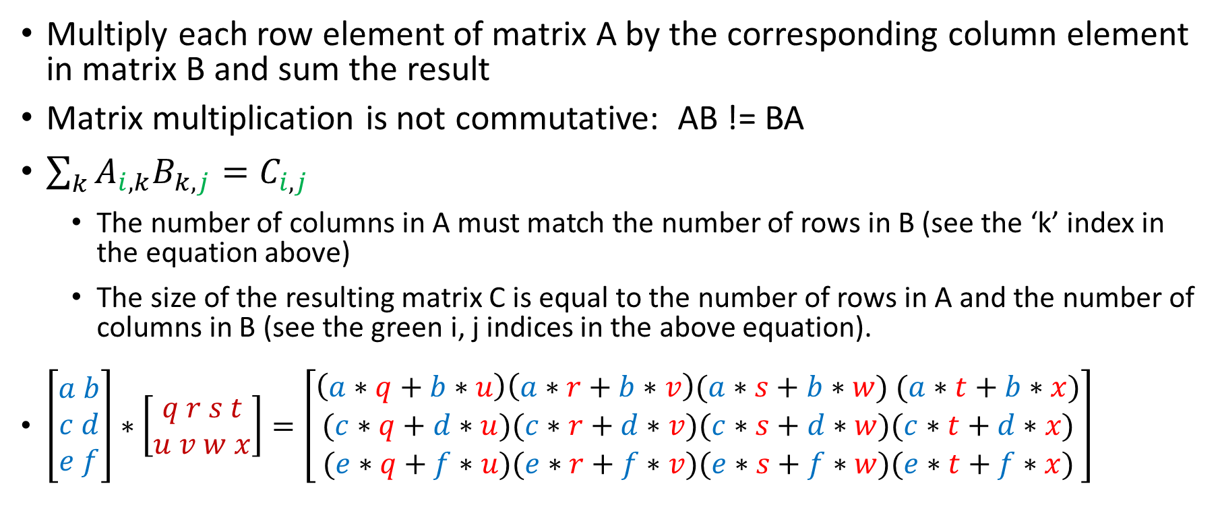
Matrix Dot Product
Multiply each row element of matrix A by the corresponding column element in matrix B and sum the result
Matrix multiplication is not commutative: AB != BA
$\sum_{k}{A_{i,k}B_{k,j}=C_{i,j}}$
The number of columns in A must match the number of rows in B (see the ‘k’ index in the equation above)
The size of the resulting matrix C is equal to the number of rows in A and the number of columns in B (see the green i, j indices in the above equation).
$\left[\begin{aligned}a b \\ c d \\ e f\end{aligned}\right]∗\left[\begin{aligned}q r s t \\ u v w x\end{aligned}\right]=\left[\begin{aligned}\left(a∗q+b∗u\right)\left(a∗r+b∗v\right)(a∗s+b∗w) (a∗t+b∗x) \\ (c∗q+d∗u)(c∗r+d∗v)(c∗s+d∗w)(c∗t+d∗x) \\ (e∗q+f∗u)(e∗r+f∗v)(e∗s+f∗w)(e∗t+f∗x)\end{aligned}\right]$
Notes:
Good final queston

Slide 23
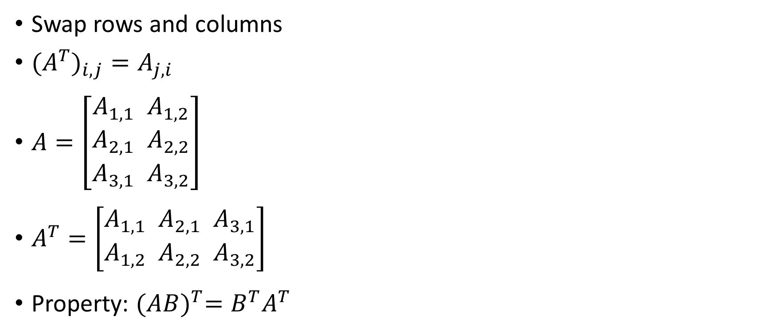
Matrix Transpose
Swap rows and columns
${{(A}^{T})}_{i,j}=A_{j,i}$
$A=\left[\begin{aligned}A_{1,1} { A}_{1,2} \\ A_{2,1}{ A}_{2,2} \\ A_{3,1}{ A}_{3,2}\end{aligned}\right]$
$A^{T}=\left[\begin{aligned}A_{1,1}{ A}_{2,1}{ A}_{3,1} \\ A_{1,2}{ A}_{2,2}{ A}_{3,2}\end{aligned}\right]$
Property: ${(AB)}^{T}=B^{T}A^{T}$

Slide 24
Tensors
A tensor is an array of numbers, that may have
zero dimensions, and be a scalar
one dimension, and be a vector
two dimensions, and be a matrix
or more dimensions.

Slide 25
Difference Between Tensor and Matrix
A matrix is a 2 dimensional grid of numbers
A tensor is a generalized matrix
A tensor includes all of the following
0 dimension (AKA scalar)
1 dimension (AKA vector)
2 dimension (AKA matrix)
Or higher dimension
A tensor is more general and flexible than a matrix
The dimension of the tensor is known as it’s “rank”. Example, a 3 dimensional numpy array is a tensor of rank 3.
Notes:
https://medium.com/@quantumsteinke/whats-the-difference-between-a-matrix-and-a-tensor-4505fbdc576c
Good final question

Slide 26
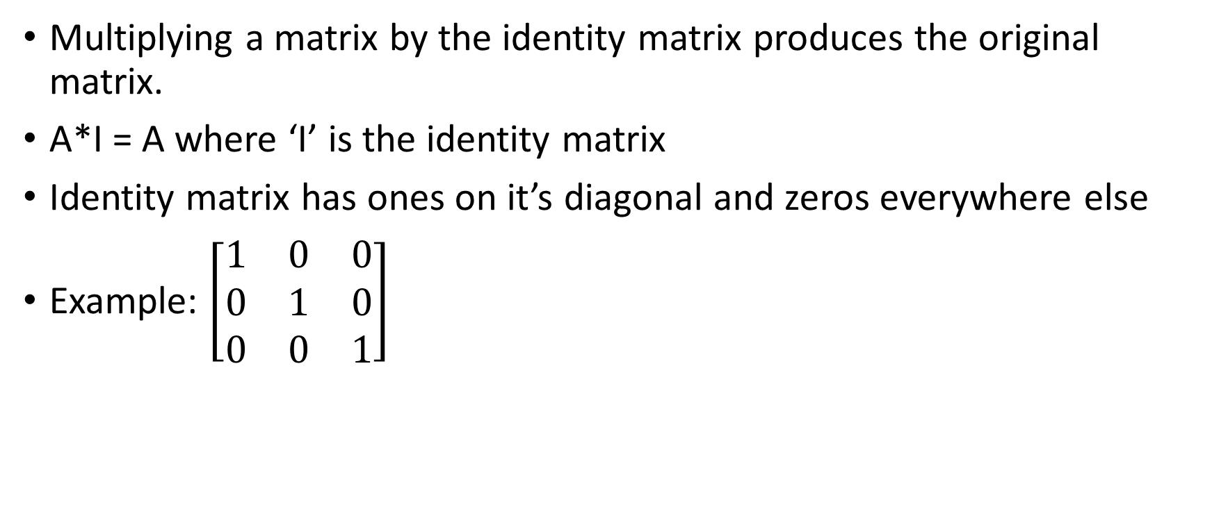
Identity Matrix
Multiplying a matrix by the identity matrix produces the original matrix.
A*I = A where ‘I’ is the identity matrix
Identity matrix has ones on it’s diagonal and zeros everywhere else
Example: $\left[\begin{matrix}1 & 0 & 0 \\ 0 & 1 & 0 \\ 0 & 0 & 1\end{matrix}\right]$

Slide 27
Linear Combinations
A linear combination is an expression constructed from a set of terms by multiplying each term by a constant and adding the results.
Example: The linear combination of the terms x and y would be constructed by multiplying each of the terms by a constant and adding.
ax + by where a and b are constants

Slide 28
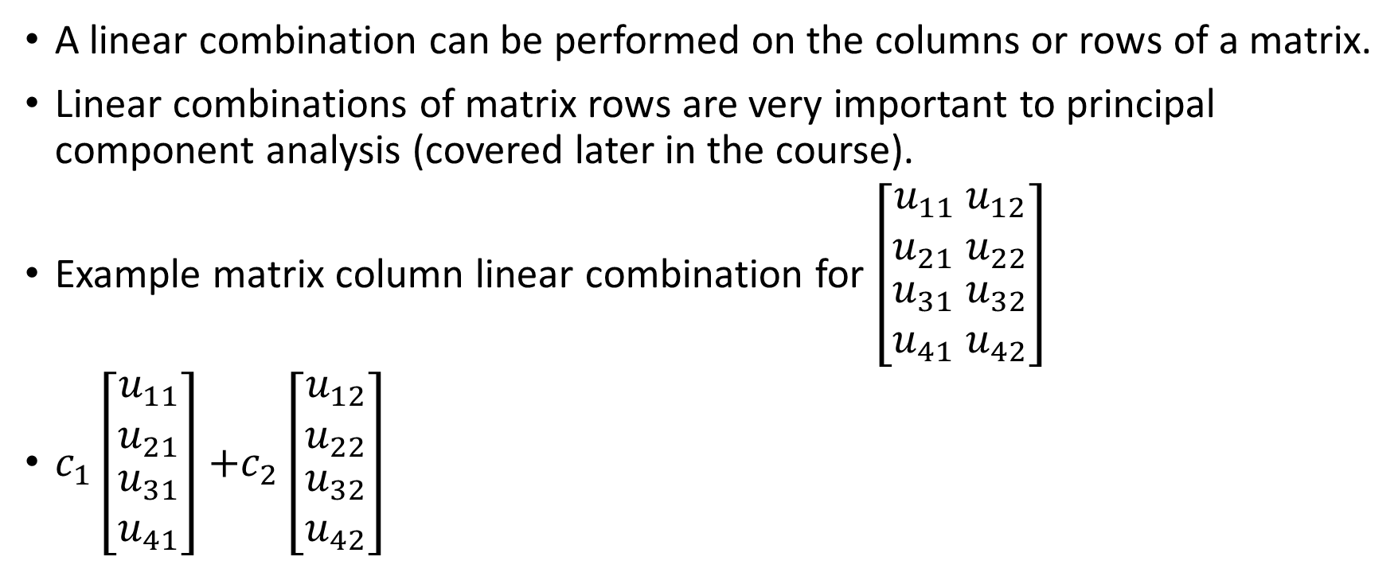
Linear Combinations
A linear combination can be performed on the columns or rows of a matrix.
Linear combinations of matrix rows are very important to principal component analysis (covered later in the course).
Example matrix column linear combination for $\left[\begin{matrix}u_{11} u_{12} \\ u_{21}{ u}_{22} \\ \begin{aligned}u_{31}{ u}_{32} \\ u_{41}{ u}_{42}\end{aligned}\end{matrix}\right]$
$c_{1}\left[\begin{matrix}u_{11} \\ u_{21} \\ \begin{aligned}u_{31} \\ u_{41}\end{aligned}\end{matrix}\right]$ $+c_{2}\left[\begin{matrix}u_{12} \\ u_{22} \\ \begin{aligned}u_{32} \\ u_{42}\end{aligned}\end{matrix}\right]$
Notes:
Good final question

Slide 29
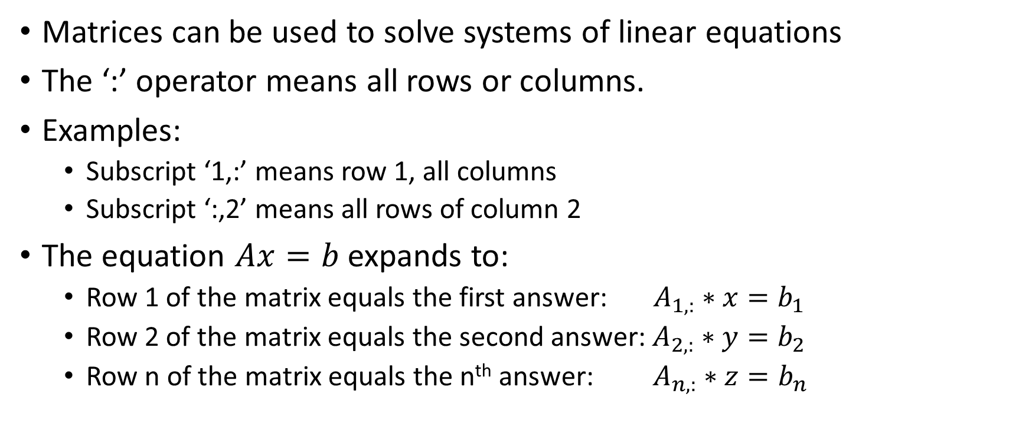
Systems of Equations
Matrices can be used to solve systems of linear equations
The ‘:’ operator means all rows or columns.
Examples:
Subscript ‘1,:’ means row 1, all columns
Subscript ‘:,2’ means all rows of column 2
The equation $Ax=b$ expands to:
Row 1 of the matrix equals the first answer: $A_{1,:}∗x=b_{1}$
Row 2 of the matrix equals the second answer: $A_{2,:}∗y=b_{2}$
Row n of the matrix equals the n^{th} answer: $A_{n,:}∗z=b_{n}$

Slide 30
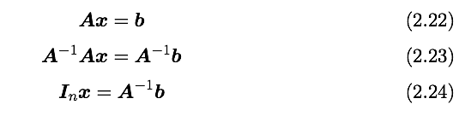
Solving Systems of Equations
Matrix inverse:
Solving a system using an inverse:
Numerically unstable, but useful for abstract analysis

Slide 31
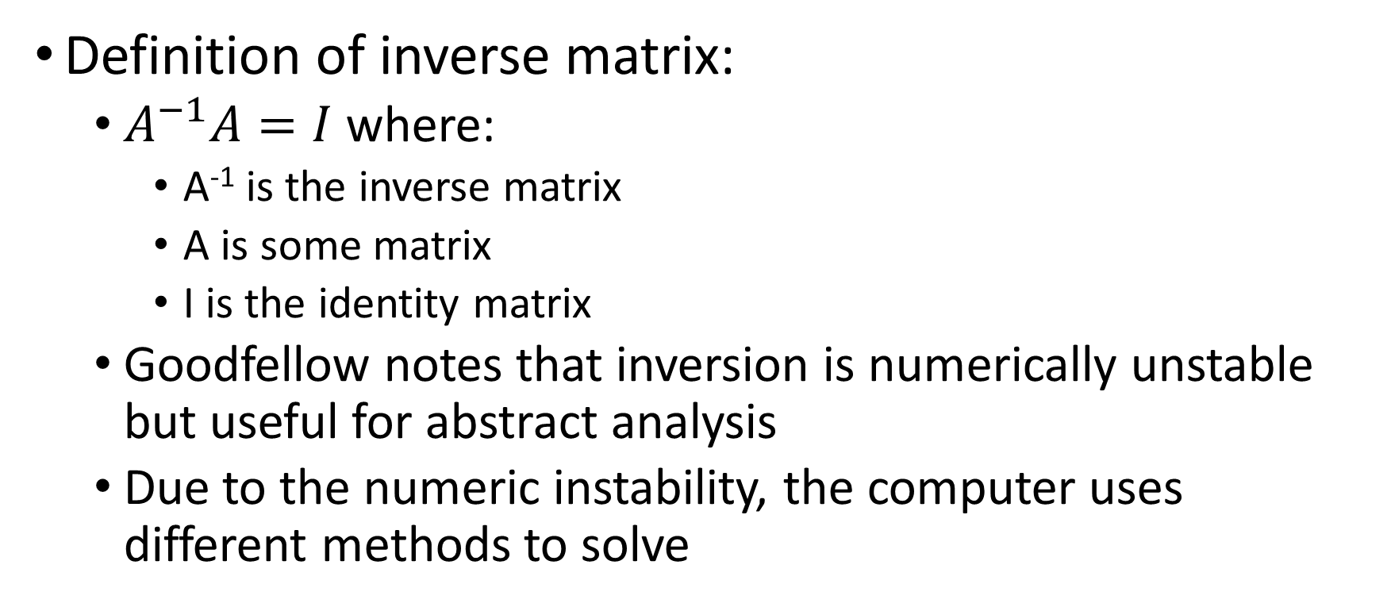
Matrix Inversion
Definition of inverse matrix:
$A^{−1}A=I$ where:
A⁻¹ is the inverse matrix
A is some matrix
I is the identity matrix
Goodfellow notes that inversion is numerically unstable but useful for abstract analysis
Due to the numeric instability, the computer uses different methods to solve

Slide 32
Credits
This presentation used the following sources:
Professor Acuna’s Syracuse University IST-718 Lecture Slides
https://www.deeplearningbook.org/slides/02_linear_algebra.pdf
https://www.ling.upenn.edu/courses/cogs501/LinearAlgebraReview.html

